Slide 1
6MMCS002 Digital Marketing, Social Media & Web Analytics
Week 2 – Information Retrieval Systems and Search Engines; how a Search engine works
Dr Vassiliki Bouki
boukiv@wmin.ac.uk

Slide 2
Some terms...
you might have come across and you use:
Information Retrieval (IR)
Search Engines (SE)
Data Retrieval
Discussion: what do you understand with each of the above?
Try to think of an example / a sentence where you use the term / a definition.
In all the above there is an implication...

Slide 3
Information Retrieval (IR)
[‘informal’ definition] Information Retrieval is finding material (usually documents) of an unstructured nature (usually text) that satisfies the information queries / needs of a user.
[‘formal’ definition] “Information retrieval is the activity of obtaining information resources relevant to an information need from a collection of information resources. Searches can be based on metadata or on full-text (or other content-based) indexing.
Automated information retrieval systems are used to reduce what has been called "information overload". Many universities and public libraries use IR systems to provide access to books, journals and other documents. Web search engines are the most visible IR applications.”
http://en.wikipedia.org/wiki/Information_Retrieval_System
Information Retrieval deals with: representation, storage and access to documents (or representations of documents).

Slide 4
Related research fields
Database Management
Library and Information Science
Artificial Intelligence (AI)
Natural Language Processing & Understanding
Machine Learning

Slide 5
Data vs Information Retrieval
Data Retrieval
Information Retrieval
What we retrieve
Structured Data / Clear Semantics
Mostly unstructured / free text with metadata
Queries
Formally defined queries/ unambiguous
Vague / ambiguous / often expressed in Natural Language
Results
Sometimes relevant – others not relevant
Exact
Interaction
One-shot queries
Interaction is important

Slide 6
Search Engines
Web Search Engines are the most visible / well-known IR applications
Usually when we refer to a search engine we mean a web search engine.
Search engines are:
complex aggregates of several pieces of software that allow users
to enter a query (a combination of keywords) and
receive as output an ordered list of links, ranked according to their relevance to the query.

Slide 7
The need for SE
How big is the Web???
The size of the web is based on the estimations of the numbers of pages indexed by Google, Bing, Yahoo Search.
There are more than 150 billion searchable indexed Web pages on the Internet. http://www.websitemagazine.com
Furthermore, it has been suggested that the Internet doubles every three years.
Whatever the exact number is... It becomes useless if we cannot search it.

Slide 8
Search Engines
Several statistics from the last four years show how much we depend on search engines:
Search engines rank second only to e-mail as the most popular online activity.
On any given day in early 2012, more than half of the adults using the Internet use a search engine (59%). That is double the 30% of internet users who were using search engines on a typical day in 2004. (http://www.pewinternet.org/2012/03/09/search-engine-use-2012/)
http://www.pewinternet.org/ ***
*** The Pew Research Center is an American think tank based in Washington, D.C., that provides information on social issues, public opinion, and demographic trends shaping the United States and the world.

Slide 9
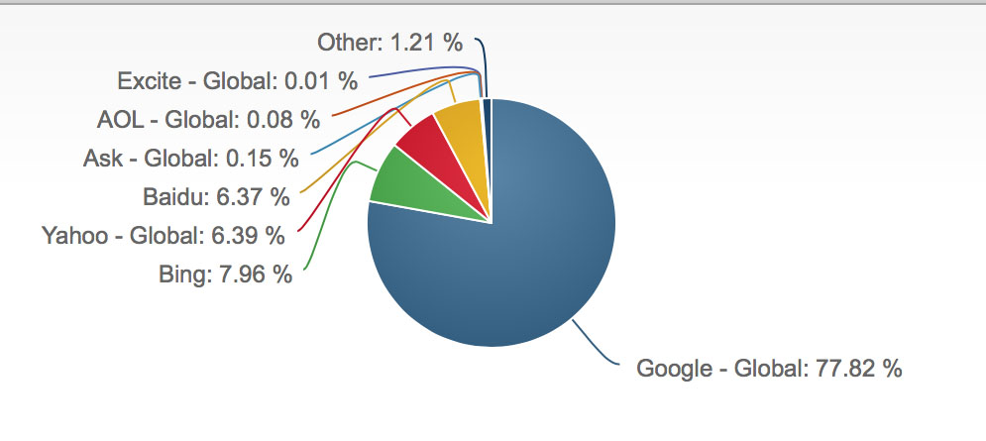
Search Engines
December 2016 – Desktop Search Engine Market Share:
https://www.netmarketshare.com/search-engine-market-share.aspx?qprid=4&qpcustomd=0

Slide 10
Search Engines (from your experience)
How many SEs do you use? Which ones?
Is it a positive or negative experience?
How do you form the query?
How often do you use a search engine?
Did you use a search engine today?
Are you happy with search engines monitoring your browsing behaviour in order to offer more customised / personalised results?

Slide 11
How does a Search Engine work?
Discussion:
If you had to search into a 500 pages long book to find a specific piece of information (e.g. a definition) what would you do?
What if the book was written in a language you do not understand?

Slide 12
How does a SE work?
If we understand how a SE works:
It is easier to understand how to optimize a SE
It is easier to understand what we mean with web analytics
(Here we’ll see the ‘big picture’. Bibliographical references are provided if you wish to go into more details)

Slide 13
Let’s see an example
Consider the following three paragraphs:
P1: “ EBSY12 module Introduction: EBSY612 is about web and social media analytics. In EBSY612 we’ll examine the following concepts: Search Engine Optimization, Google white and black hat, Web Analytics, Google Analytics.”
P2: “EBSY612 Assessment: The assessment consists of two pieces of coursework: coursework one assesses learning objectives 1, 2 and 3. Coursework 2 assesses learning objectives 4 and 5”
P3: “EBSY612 Reading list: There are two books in the main bibliography list. Further titles and online resources will be given in each lecture.”

Slide 14
Let’s see an example
How would you answer a query such as:
“Information about the assessment in EBSY612”
Which paragraph would you suggest as answer? P1, P2 or P3
WHY?
Assume that the above paragraphs are in a language you do not understand (e.g. Spanish)?
In the next slide I used Goole translation (https://translate.google.co.uk) to translate the above paragraphs and the input question in Spanish.

Slide 15
Let’s see an example
Input Question: “Información sobre la evaluación en EBSY612"
P1: “EBSY612 lista de lecturas: Hay dos libros en la lista principal bibliografía. Otros títulos y recursos en línea se impartirán en cada conferencia.”
P2: “Módulo EBSY12 Introducción: EBSY612 se trata web y análisis de medios sociales. En EBSY612 vamos a examinar los siguientes conceptos: la optimización del Search Engine, sombrero blanco y negro Google, Web Analytics, Google Analytics.”
P3: “Evaluación EBSY612: La evaluación consta de dos piezas de los cursos: de cursos uno evalúa los objetivos de aprendizaje 1, 2 y 3. Cursos 2 evalúa el aprendizaje de los objetivos 4 y 5. ”
HOW WOULD YOU IDENTIFY THE CORRECT ANSWER???

Slide 16
Let’s see an example
 | Información | evaluación | EBSY612
P1 | 0 | 0 | 1
P2 | 0 | 0 | 3
P3 | 0 | 2+2 | 1
STEP 2: How many times does each word appear in each paragraph?
Información
evaluación
EBSY612
Input Question: “Información sobre la evaluación en EBSY612"
P1: “EBSY612 lista de lecturas: Hay dos libros en la lista principal bibliografía. Otros títulos y recursos en línea se impartirán en cada conferencia.”
P2: “Módulo EBSY12 Introducción: EBSY612 se trata web y análisis de medios sociales. En EBSY612 vamos a examinar los siguientes conceptos: la optimización del Search Engine, sombrero blanco y negro Google, Web Analytics, Google Analytics.”
P3: “Evaluación EBSY612: La evaluación consta de dos piezas de los cursos: de cursos uno evalúa los objetivos de aprendizaje 1, 2 y 3. Cursos 2 evalúa el aprendizaje de los objetivos 4 y 5. ”
HOW WOULD YOU IDENTIFY THE CORRECT ANSWER???
STEP 3: Decide which paragraph is more relevant
STEP 1: Identify main words (keywords) in the input question

Slide 17
Let’s see an example
 | Libros | EBSY612
P1 | 1+1 | 1
P2 | 0 | 3
P3 | 0 | 1
STEP 2: How many times does each word appear in each paragraph?
"Libros
EBSY612
What if the input question is: "Libros para EBSY612""
P1: “EBSY612 lista de lecturas: Hay dos libros en la lista principal bibliografía. Otros títulos y recursos en línea se impartirán en cada conferencia.”
P2: “Módulo EBSY12 Introducción: EBSY612 se trata web y análisis de medios sociales. En EBSY612 vamos a examinar los siguientes conceptos: la optimización del Search Engine, sombrero blanco y negro Google, Web Analytics, Google Analytics.”
P3: “Evaluación EBSY612: La evaluación consta de dos piezas de los cursos: de cursos uno evalúa los objetivos de aprendizaje 1, 2 y 3. Cursos 2 evalúa el aprendizaje de los objetivos 4 y 5. ”
HOW WOULD YOU IDENTIFY THE CORRECT ANSWER???
STEP 1: Identify main words (keywords) in the input question
STEP 3: Decide which paragraph is more relevant

Slide 18
Remark on the example
Does it make sense to create the above tables every time a question is asked or there is an easier way?

Slide 19

How does a SE work?
Which one of the following two statements do you think it is closer to truth?
A. When a user submits a query in a SE, the SE starts searching the web to identify documents that could answer the specific query.
B. When a new page / document is added on the web, (submitted to a SE) a SE analyses this document and extracts information in order to use it if a relevant query will come up.

Slide 20
The structure of a SE
A SE operates in the following order:
Web crawling (operated by SPIDERS)
Create Indexes
Search

Slide 21
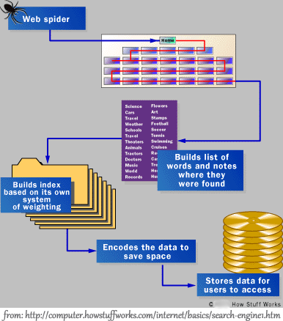
The structure of a SE
http://computer.howstuffworks.com/internet/basics/search-engine1.htm

Slide 22
The structure of a SE
Search Engines use spiders to index websites.
When a website page is submitted to a search engine (by completing their required submission page), the search engine spider will index the entire site.
A ‘spider’ is an automated program that is run by the search engine system. A Spider visits a web site, reads the content on the actual site, the site’s Meta tags and also follows the links that the site connects.
The spider then returns all that information back to a central depository, where the data is indexed. It will visit each link you have on your website and index those sites as well. Cont..

Slide 23
The structure of a SE
The spider will periodically return to the sites to check for any information that has changed.
The frequency with which this happens is determined by the moderators of the search engine.
A spider is almost like a book where it contains the table of contents, the actual content and the links and references for all the websites it finds during its search, and it may index up to a million pages a day. Cont..

Slide 24
The structure of a SE
Further more, search engines perform a search when a query is asked.
When you ask a search engine to locate information, it is actually searching through the index which it has created and not actually searching the Web.
Different search engines produce different rankings because not every search engine uses the same algorithm to search through the indices.
One of the things that a search engine algorithm scans for is the frequency and location of keywords on a web page, but it can also detect artificial keyword stuffing or spamming.
Then the algorithms analyze the way that pages link to other pages in the Web. By checking how pages link to each other, an engine can both determine what a page is about, if the keywords of the linked pages are similar to the keywords on the original page.

Slide 25
How does a SE work?
A video by Google’s Expert that summarises the above:
http://www.youtube.com/watch?v=BNHR6IQJGZs#t=15

Slide 26
How does a SE work?
Apparently the above description is very simplistic and leaves out the most important part: the ‘information retrieval’.
How could a program retrieve information and index a document in natural language? / how could a program retrieve information from a query formed by the user in natural language?

Slide 27
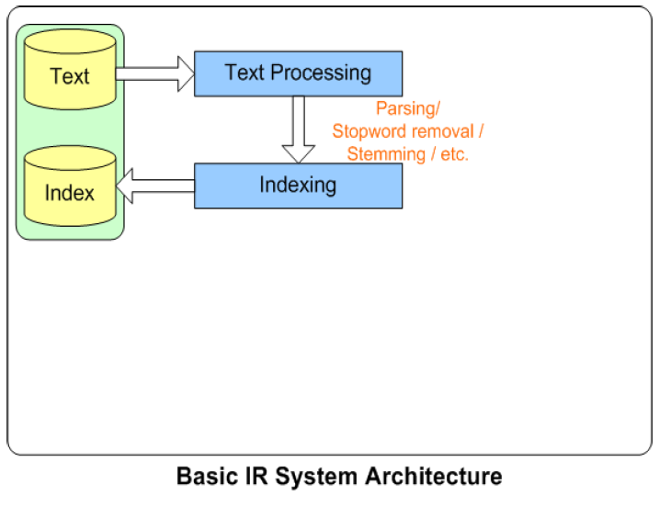
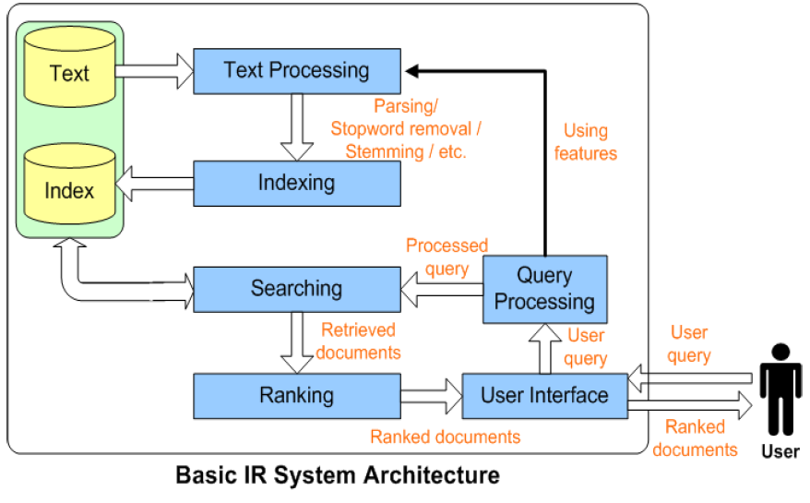
IR Architecture
From NECTEC’s labs; the file has been removed
Indexing
Retrieval

Slide 28
IR Architecture – Text Processing
Text Processing:
Tokenization: break into ‘tokens’ (keywords)
Stem tokens to ‘root’ words e.g. Computer -> comput
Remove common ‘stopwords’ e.g. a, the, it
Strip unwanted characters/markup e.g. HTML tags, punctuation, numbers, etc.
Detect common phrases and named entities - possibly by using a domain specific dictionary

Slide 29
IR Architecture – retrieval models
Boolean models
Vector space models (statistical/algebraic)
Probabilistic models
It is beyond the scope of this module to go through retrieval models but you are strongly advised to read about these models if you want to get a better understanding of how SEs work. http://en.wikipedia.org/wiki/Information_retrieval

Slide 30
The importance of language
Few years ago Powerset secured the exclusive license for natural language processing technology from Xerox's Palo Alto Research Centre.
(other players: Google – Hakia )
Queries such as: “books by children” & “books for children” must produce DIFFERENT results but the main keywords (‘books’ ‘children’) are the same.
“..Keywords are an "impoverished language.” ”– Barney Pell, CEO (Chief Executive Officer) of Powerset
On his personal blog, Pell argues that keywords are the equivalent of studying a foreign language for a year: you can get around, but can't communicate with much richness. Searching for "book by children" and "book about children" should produce greatly different results, but search engines today generally throw out the prepositions and treat both queries the same way. http://arstechnica.com/uncategorized/2007/02/8808/

Slide 31
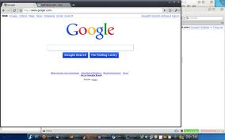
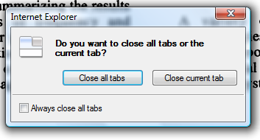
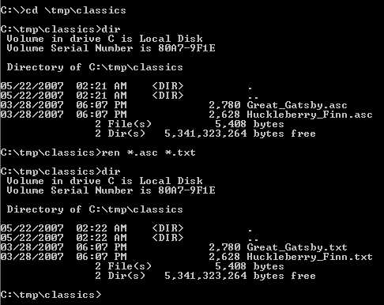
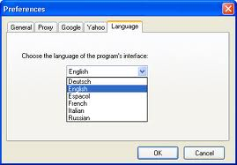
The importance of language
Computers do NOT understand language!
‘machine-driven’ communication &
‘user-driven’ communication

Slide 32
The importance of language
Language is a mystery ...
Syntax (HOW we say something)
Semantic (MEANING of what we say)
Pragmatics (RELATIVE meaning)
Semantic Web and the knowledge Graph

Slide 33
Further developments: Semantic Web
The Semantic Web is a collaborative movement led by the international standards body, the World Wide Web Consortium (W3C).
The Semantic Web aims at converting the current web dominated by unstructured and semi-structured documents into a "web of data".
http://en.wikipedia.org/wiki/Semantic_Web
Metadata & Ontologies
An ”ontology” formally represents knowledge as a set of concepts within a domain, and the relationships between pairs of concepts. It can be used to model a domain and support reasoning about entities.
The automatic creation of ontologies is a task that involves many disciplines.
The goal of ’ontology learning’ is to semi-automatically extract relevant concepts and relations from a given corpus or other kinds of data sets to form an ontology.
Ontology language: a formal language used to encode the ontology → OWL

Slide 34
Further developments: The Knowledge Graph
http://www.youtube.com/watch?feature=player_embedded&v=mmQl6VGvX-c
“The Knowledge Graph enables you to search for things, people or places that Google knows about—landmarks, celebrities, cities, sports teams, buildings, geographical features, movies, celestial objects, works of art and more—and instantly get information that’s relevant to your query. This is a critical first step towards building the next generation of search, which taps into the collective intelligence of the web and understands the world a bit more like people do.”
(video & text from: http://googleblog.blogspot.co.uk/2012/05/introducing-knowledge-graph-things-not.html, May 2012)

Slide 35
Next Week
By now you should have a clear picture of what search engines are and how they work.
Next week we’ll present and discuss the most common techniques to optimize a search engine in order to make a web site more visible.

